Slide 1
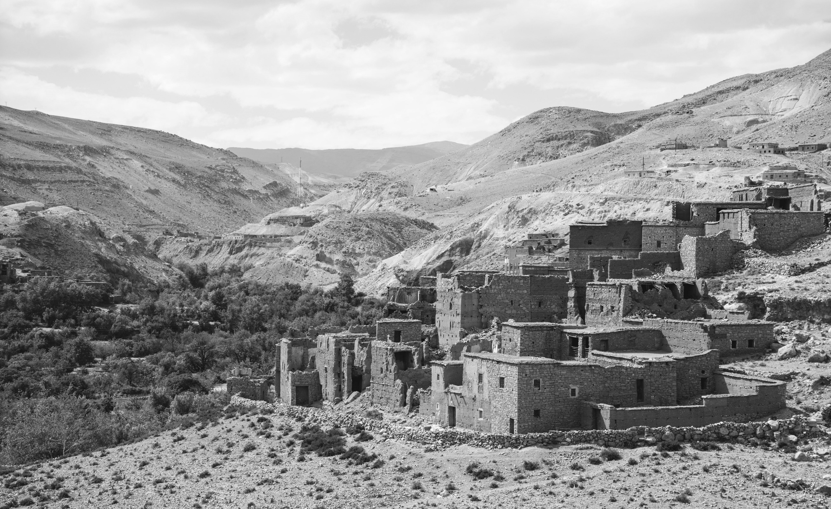
Graph Optimization Problem
Modeling and Approximate Solutions
ELMARJOU YOUSSEF
JUNE 2022

Slide 2
1
Appendix
6
1
Motivation
5
2
Attempt
Problematic
Maximum Flow Problem
4
3
Shortest Path Problem

Slide 3
2
Motivation

Slide 4
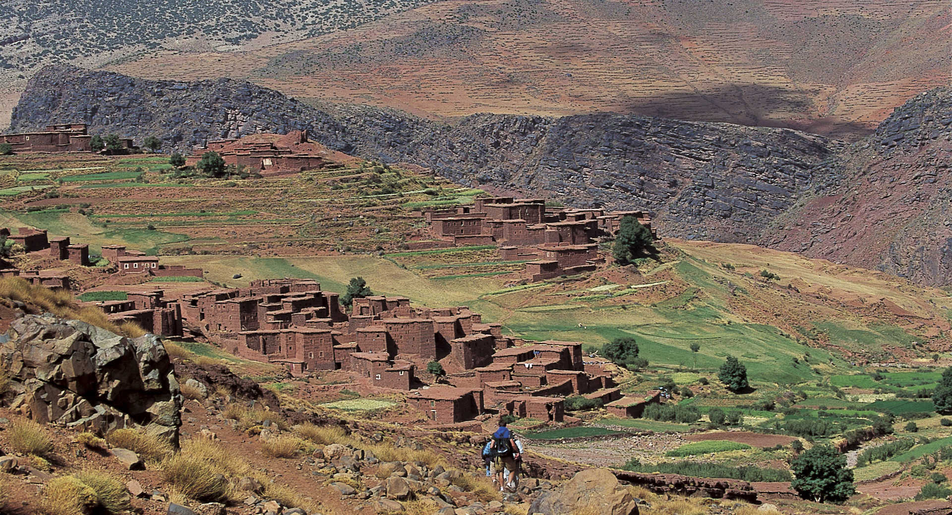
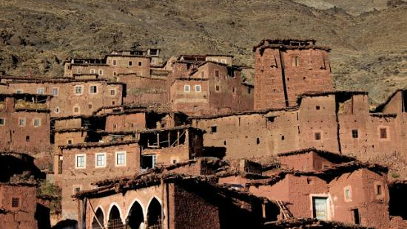
3
Figure 1
Figure 2
The Moroccan Berber villages face a crucial lack of essential community life infrastructure, notably hospitals.

Slide 5
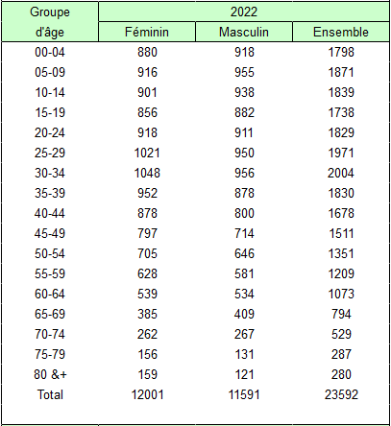
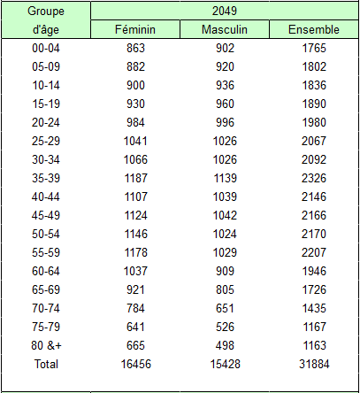
4
Age group
Age group
women
men
all
women
men
all
Figure 3 : Actual Statistics
Figure 4 : Projections in 2049
These villages are experiencing significant rural exodus, as indicated by the forecasts from the HCP.
- Definition : Haut-Commissariat au Plan or HCP: Moroccan institution responsible for the analysis and publication of official statistics in Morocco.

Slide 6
5
Problematic
In a given network of villages, what is the ideal location for building a hospital?
Under geographical constraints, what is the optimal path that a set of ambulances can take to reach a specific village?

Slide 7
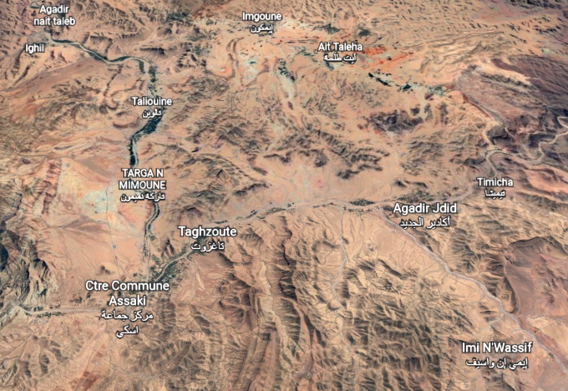
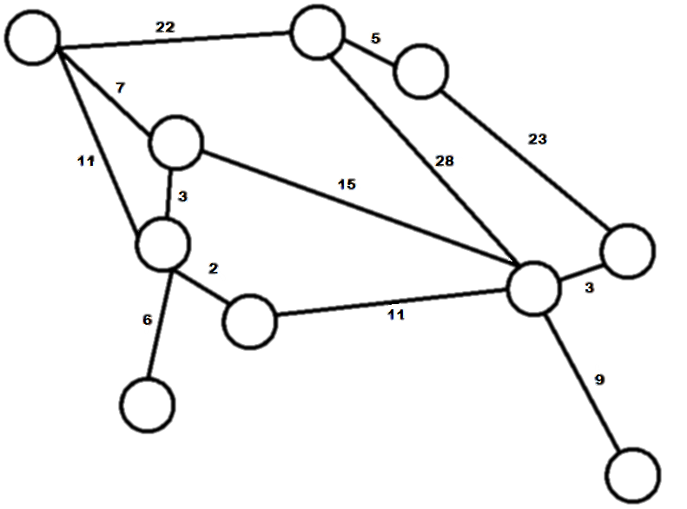
6
Graphical representation of a village area
Figure 5 : Screenshot of a village area south of the High Atlas Mountains.
Figure 6: Equivalent weighted graph

Slide 8
7
Shortest Path Problem
Statement : Given a weighted graph, directed or not, which path should be chosen between two nodes in such a way that the sum of the weights of its constituent edges is minimal.

Slide 9
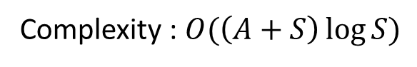
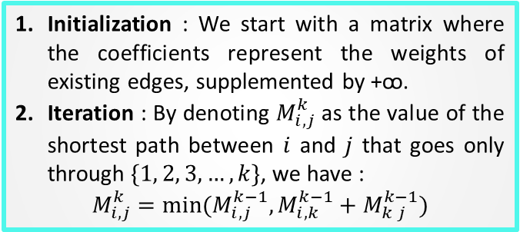
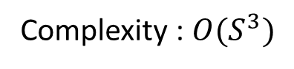
8
Floyd-Warshall Algorithm
Dijkstra Algorithm
Initialization : We start with a matrix where the coefficients represent the weights of existing edges, supplemented by +ꚙ.
Iteration : By denoting $M_{i, j}^{k}$ as the value of the shortest path between $i$ and $j$ that goes only through $\{1, 2, 3, …, k\}$, we have :
$$M_{i, j}^{k}=min⁡(M_{i, j}^{k−1},M_{i, k}^{k−1}+M_{k j}^{k−1})$$
Initialization : Each vertex is labeled with +ꚙ except for the initial starting vertex, which is initialized with 0.
Iteration : We update the labels of the successors of the unreached vertex with the smallest valuation.
Complexity : $O(S^{3})$
Complexity : $O(\left(A+S\right)\log{S})$

Slide 10
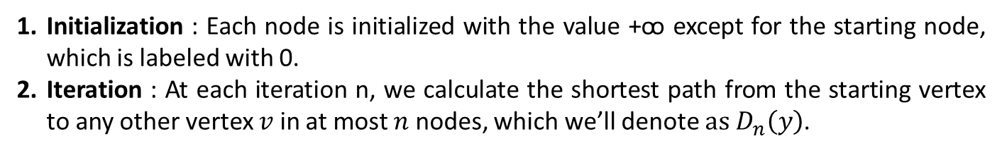
9
Bellman-Ford Algorithm
Initialization : Each node is initialized with the value +ꚙ except for the starting node, which is labeled with 0.
Iteration : At each iteration n, we calculate the shortest path from the starting vertex to any other vertex $v$ in at most $n$ nodes, which we’ll denote ${as D}_{n}\left(y\right)$.

Slide 11
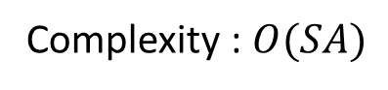
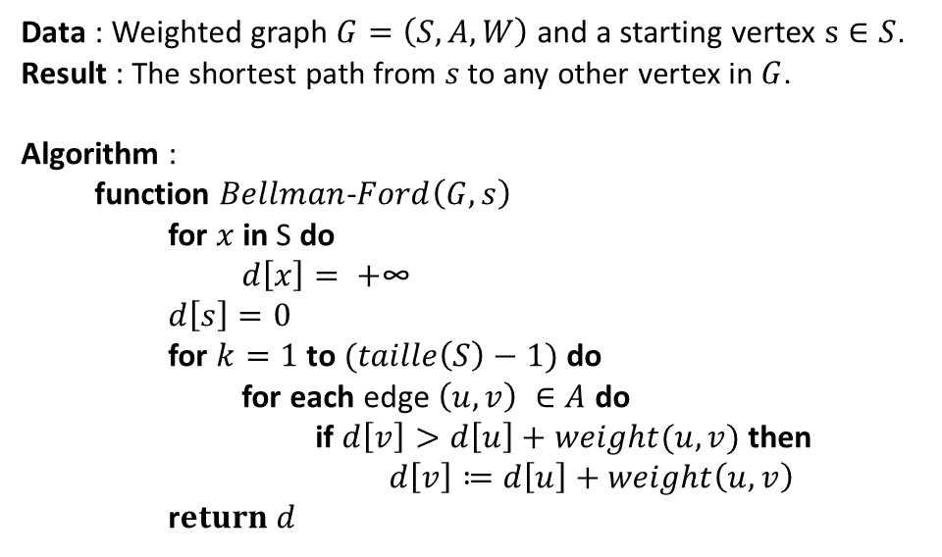
10
Bellman-Ford Algorithm
Data : Weighted graph $G=\left(S, A, W\right)$ and a starting vertex $s∈S$.
Result : The shortest path from 𝑠 to any other vertex in $G$.
Algorithm :
function $Bellman$-$Ford\left(G, s\right)$
for $x$ in S do
$d\left[x\right]= +\text{∞}$
$d\left[s\right]=0$
for $k=1$ to $(taille\left(S\right)−1)$ do
for each edge $\left(u, v\right) ∈A$ do
if $d\left[v\right]>d\left[u\right]+weight(u, v)$ then
$d\left[v\right]≔d\left[u\right]+weight\left(u, v\right)$
r$eturn d$
Complexity : $O(SA)$

Slide 12
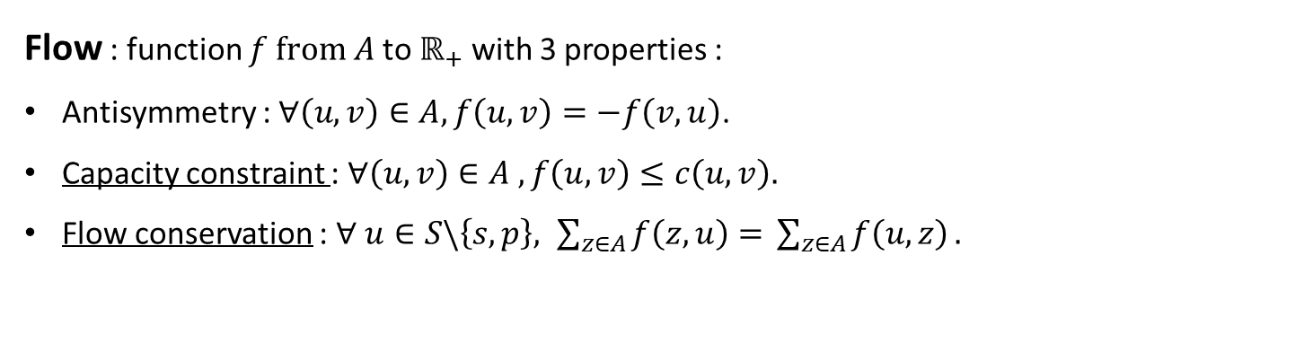
11
Maximum Flow Problem
Flow Network : graph $\left(S, A, c, f\right)$ where two edges are particular : the source $s$ and the sink $p$. It’s equipped with a flow $f$and a capacity $c$, function from $A$ to $ℝ_{+}$.
Flow : function $f from$ $A$ to $ℝ_{+}$ with 3 properties :
Antisymmetry : $∀\left(u, v\right)∈A, f\left(u, v\right)=−f\left(v, u\right)$.
Capacity constraint : $∀\left(u, v\right)∈A , f\left(u, v\right)≤c\left(u, v\right).$
Flow conservation : $∀ u∈S\backslash \left\{s, p\right\}, \sum_{z∈A}{f\left(z, u\right)= }\sum_{z∈A}{f\left(u, z\right)}.$
Enoncé : Etant donné un réseau de flot, quel flot réalisable depuis une source vers un puit est maximal ?

Slide 13
12
Maximum Flow Problem
Statement : Given a flow network, what flow from a source to a sink is maximized, while remaining possible?

Slide 14
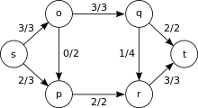
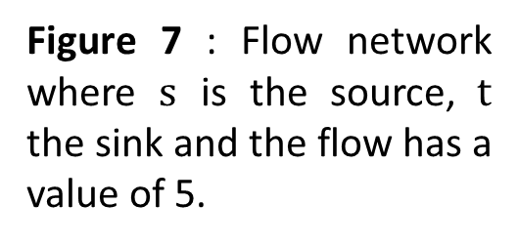
13
Example
Figure 7 : Flow network where $s$ is the source, $t$ the sink and the flow has a value of 5.

Slide 15
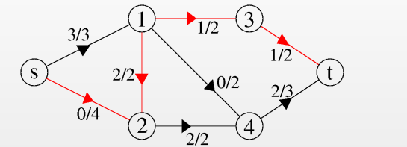
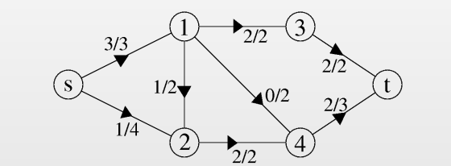
14
Ford-Fulkerson Algorithm
Augmenting path :A path from the source to the sink that allows for an improvement in the current flow.
Figure 8
Figure 9

Slide 16
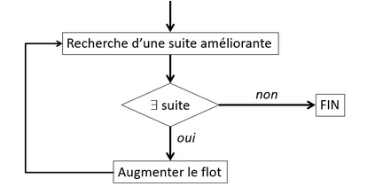
15
Ford-Fulkerson Algorithm
Searching for an augmenting path
Process : Initially, we start with a zero flow. Then, as long as an augmenting path exists, we improve the flow.
path
no
END
yes
Improve the flow
Figure 10 : Ford-Fulkerson Algorithm application.

Slide 17
16
Attempt
Setting up a Python code comparing the time complexity of different shortest path algorithms

Slide 18
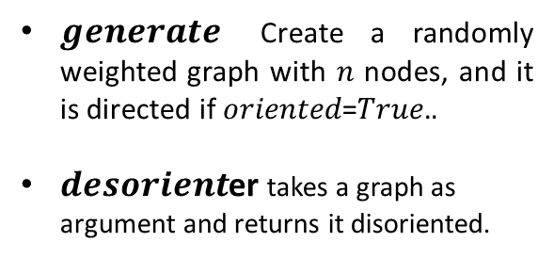
17
Attempt
def generate(n, oriented=False): l = [] for i in range(n): m = [] p = pure(i, n - 1) for x in p: m.append((x, r.randint(1, 20))) l.append(m) if not oriented: return desorienter(l) else: return l
$generate$ Create a randomly weighted graph with 𝑛 nodes, and it is directed if 𝑜𝑟𝑖𝑒𝑛𝑡𝑒𝑑=𝑇𝑟𝑢𝑒.$.$
$desorient$er takes a graph as argument and returns it disoriented.

Slide 19
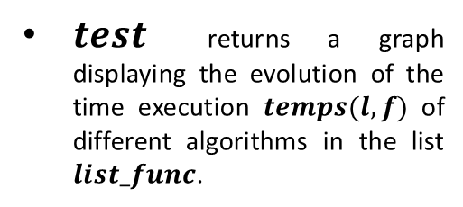
18
Réponse à la problématique
def test(densite, n, liste_func): plt.figure("Test Fonctions") c, lab = ['r', 'b', 'k', 'g', 'm'], [[], []] for k in range(len(liste_func)): for i in range(2, n + 1): for j in range(densite): l = generate(i) a = plt.scatter(i, temps(l, liste_func[k]), color=c[k]) lab[0].append(a) lab[1].append(liste_func[k].__name__) plt.legend(lab[0], lab[1]) plt.xlabel("Nombre de noeuds") plt.ylabel("Durée de l'algorithme en secondes")
$test$ returns a graph displaying the evolution of the time execution $temps(l, f)$ of different algorithms in the list $list_func$.

Slide 20
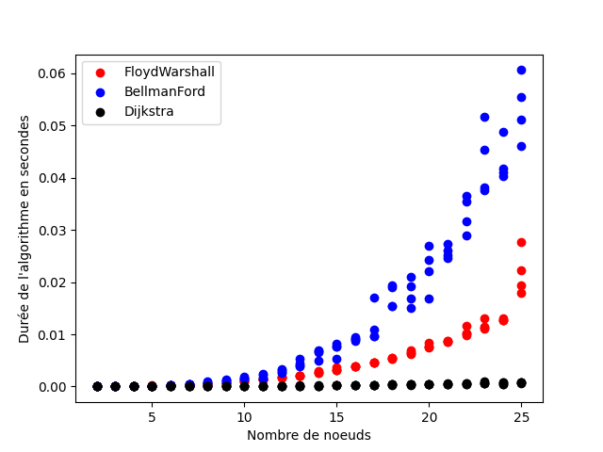
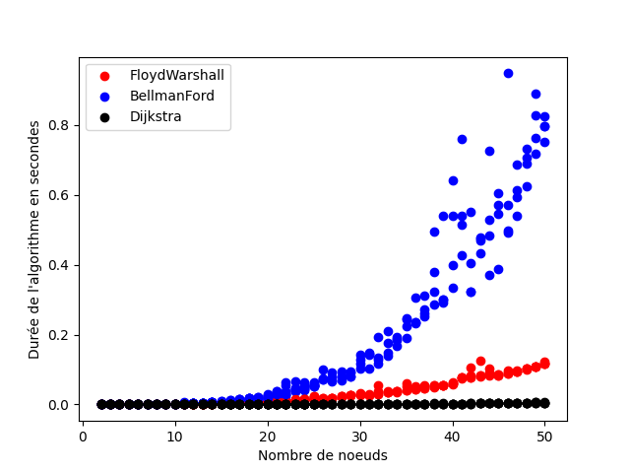
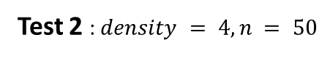
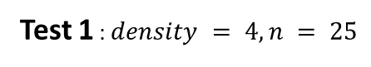
19
Attempt
Time execution in seconds
Time execution in seconds
Number of vertices
Number of vertices
Test 1 : $density = 4, n = 25$
Test 2 : $density = 4, n = 50$

Slide 21
20
Attempt
Note : An algorithm choosing an optimal node must compare the shortest paths from all vertices to the remaining ones.

Slide 22
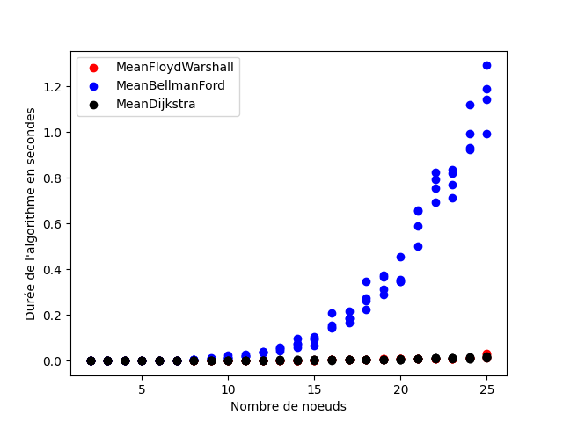
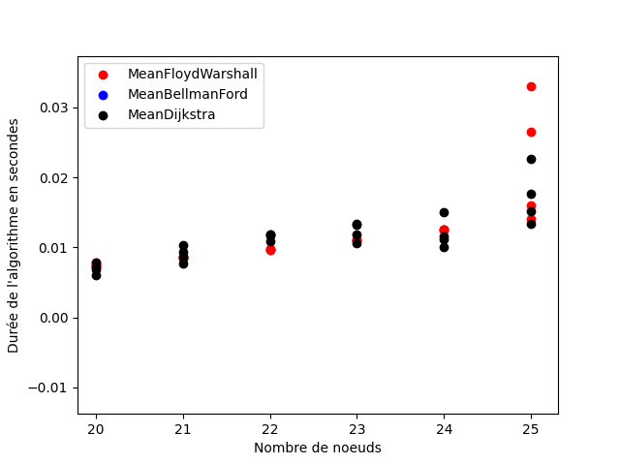
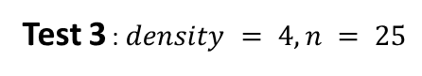
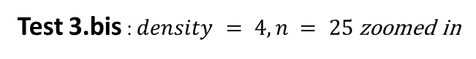
21
Attempt
Time execution in seconds
Time execution in seconds
Number of vertices
Number of vertices
Test 3 : $density = 4, n = 25$
Test 3.bis : $density = 4, n = 25$ zoomed in

Slide 23
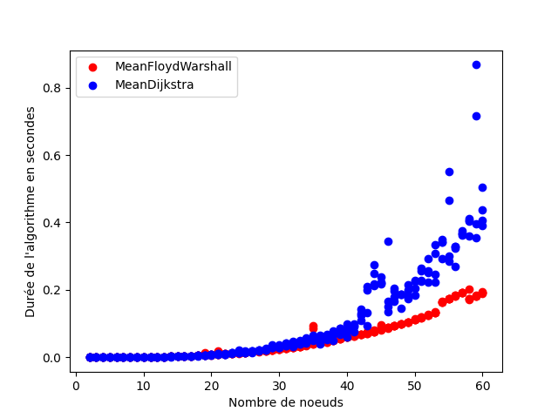
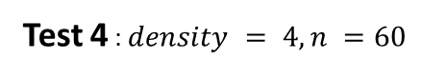
22
Attempt
Test 4 : $density = 4, n =60$
Time execution in seconds
Number of vertices

Slide 24
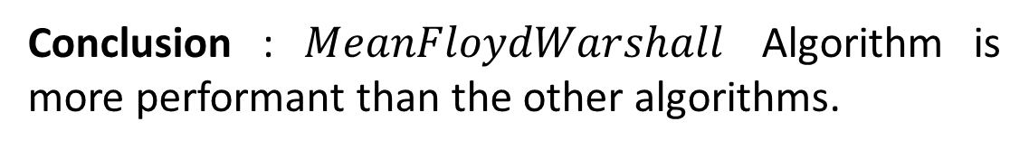
23
Attempt
Conclusion : $MeanFloydWarshall$ Algorithm is more performant than the other algorithms.

Slide 25
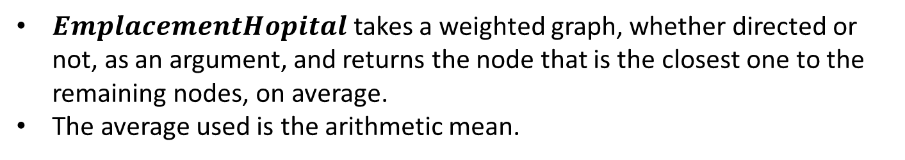
24
Attempt
def EmplacementHopital(l): return MeanFloydWarshall(l)[1]
$EmplacementHopital$ takes a weighted graph, whether directed or not, as an argument, and returns the node that is the closest one to the remaining nodes, on average.
The average used is the arithmetic mean.

Slide 26
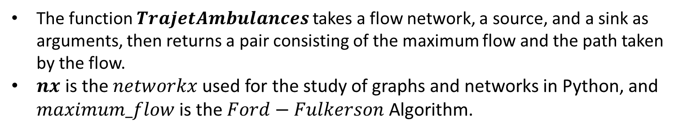
25
Attempt
def TrajetAmbulances(l, s, p): return nx.maximum_flow(a, s, p)
The function 𝑻𝒓𝒂𝒋𝒆𝒕𝑨𝒎𝒃𝒖𝒍𝒂𝒏𝒄𝒆𝒔 takes a flow network, a source, and a sink as arguments, then returns a pair consisting of the maximum flow and the path taken by the flow.
$nx$ is the $networkx$ used for the study of graphs and networks in Python, and $maximum_flow$ is the $Ford−Fulkerson$ Algorithm.

Slide 27
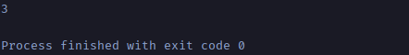
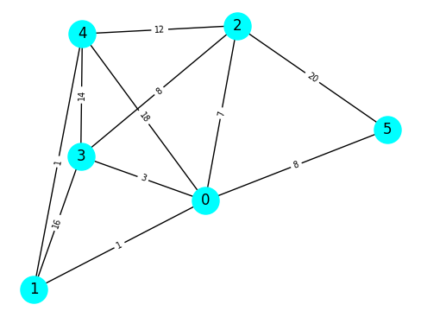
26
Attempt : example
G = generate(6, False) draw(G) print(EmplacementHopital(G))
INPUT :
OUTPUT :
This code displays a window where we can visualize the graph with 𝒅𝒓𝒂𝒘(𝑮), and the value 3 corresponding to the location of the optimal node.

Slide 28
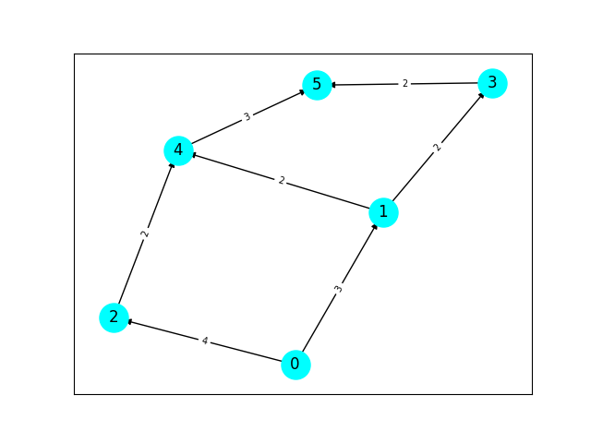
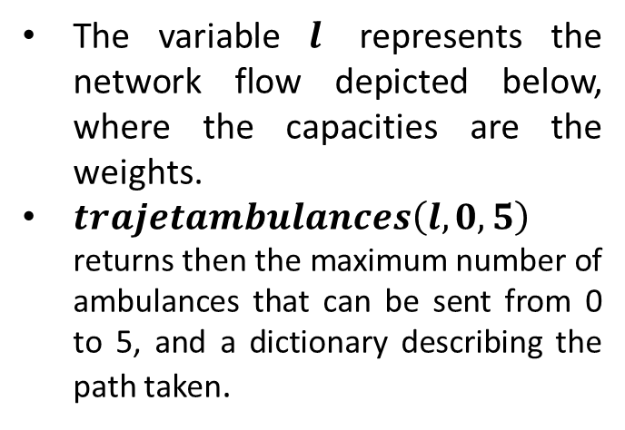
27
Attempt : example
l = [[(1, 3), (2, 4)], [(3, 2), (4, 2)], [(4,2)], [(5, 2)], [(5, 3)], []] print(trajetambulances(l, 0, 5))
INPUT :
OUTPUT :
The variable $l$ represents the network flow depicted below, where the capacities are the weights.
$trajetambulances\left(l, 0, 5\right)$ returns then the maximum number of ambulances that can be sent from 0 to 5, and a dictionary describing the path taken.

Slide 29
28
THANKS FOR YOUR READING

Slide 30
29
Annexe

Slide 31
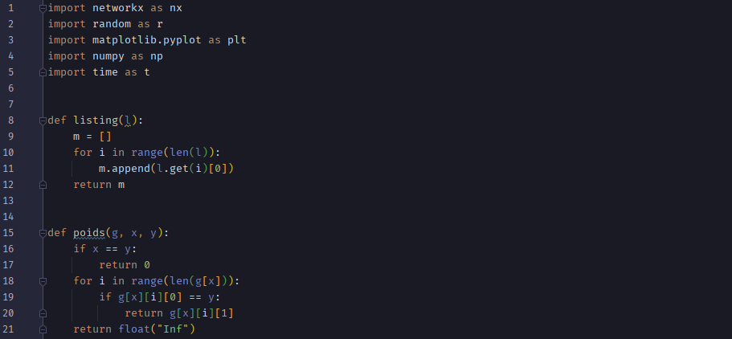
30

Slide 32
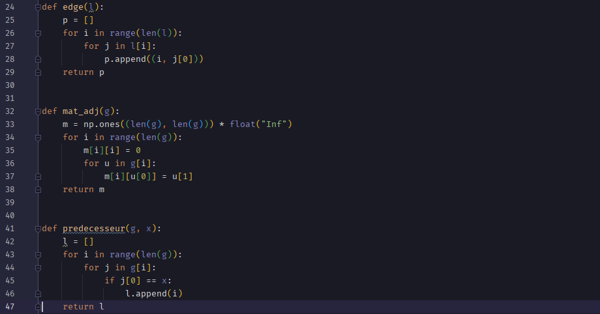
31

Slide 33
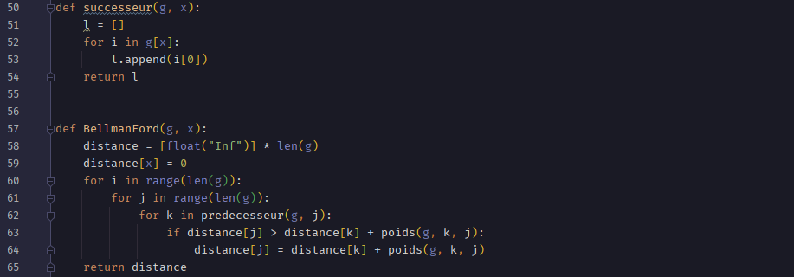
32

Slide 34
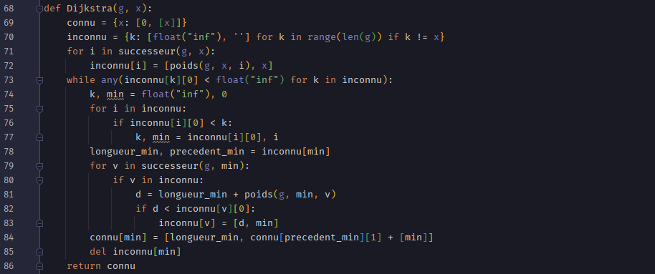
33

Slide 35
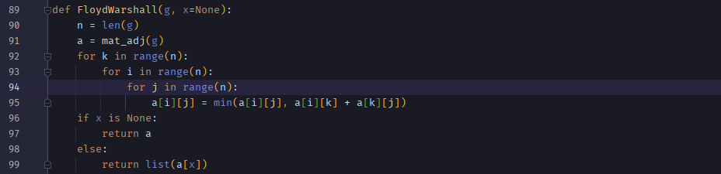
34

Slide 36
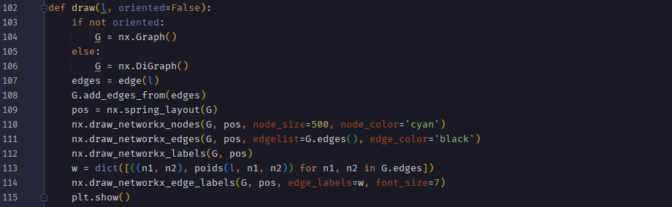
35

Slide 37
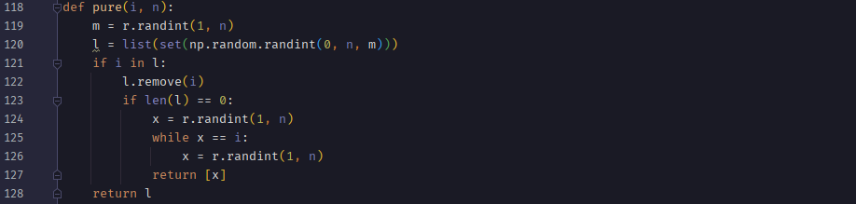
36

Slide 38
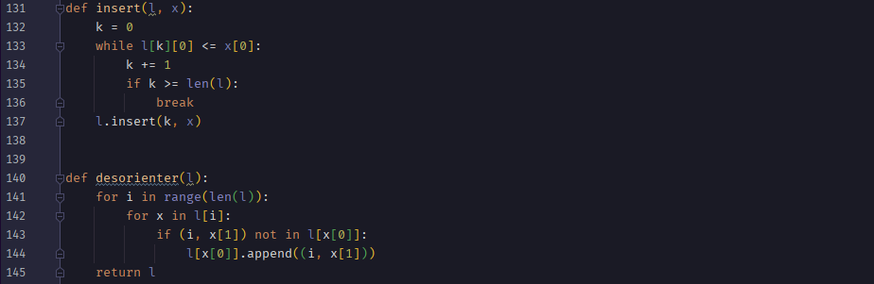
37

Slide 39
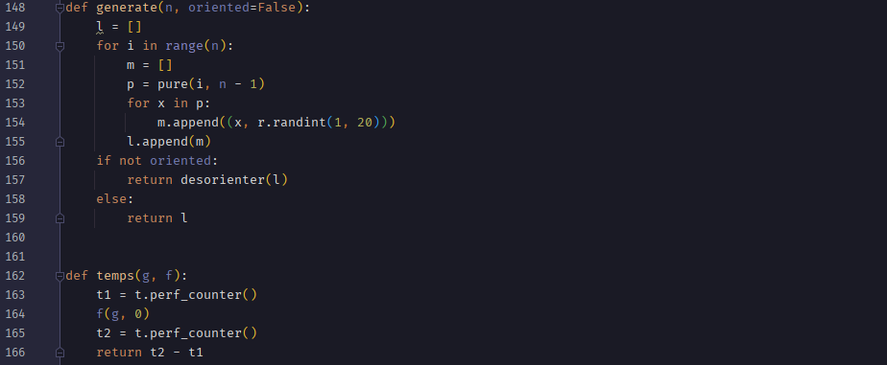
38

Slide 40
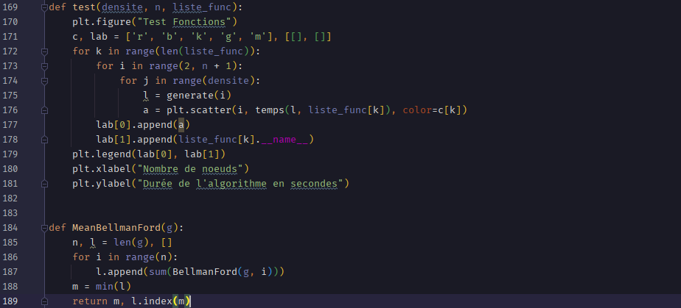
39

Slide 41
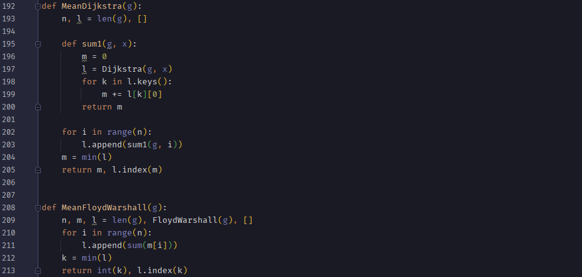
40

Slide 42
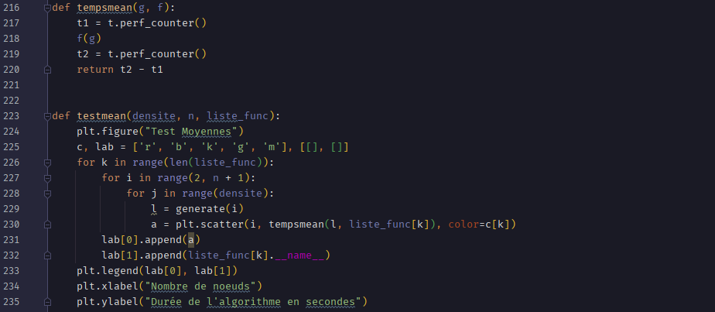
41

Slide 43

42

Slide 44

43
Failed code : part1 (for displaying random graphs)

Slide 45

44
Failed code : part2

Slide 46


45
Its results

